Slide 1
Regression

Slide 2
Introduction
Linear regression is used to predict the relationship between two variables by applying a linear equation to observed data.
There are two types of variable, one variable is called an independent variable, and the other is a dependent variable.
Linear regression is commonly used for predictive analysis.
The main idea of regression is to examine two things. First, does a set of predictor variables do a good job in predicting an outcome (dependent) variable?
The second thing is which variables are significant predictors of the outcome variable?

Slide 3
Example
The weight of the person is linearly related to their height.
this shows a linear relationship between the height and weight of the person.
According to this, as we increase the height, the weight of the person will also increase.
It is not necessary that one variable is dependent on others, or one causes the other, but there is some critical relationship between the two variables.

Slide 4
Example (Count)
In such cases, we use a scatter plot to simplify the strength of the relationship between the variables.
If there is no relation or linking between the variables then the scatter plot does not indicate any increasing or decreasing pattern.
In such cases, the linear regression design is not beneficial to the given data.
linear regression is a supervised learning algorithm that simulates a mathematical relationship between variables and makes predictions for continuous or numeric variables such as sales, salary, age, product price, etc.

Slide 5
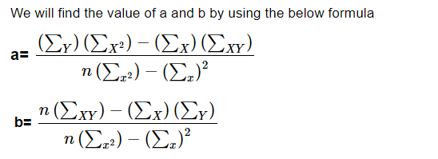
Linear Regression Formula
The equation of linear regression is similar to that of the slope formula.
We have learned this formula before in earlier classes such as a linear equation in two variables.
Y= a + bX

Slide 6
Types of Linear Regression

Slide 7
Simple linear regression
Simple linear regression reveals the correlation between a dependent variable (input) and an independent variable (output).
Primarily, this regression type describes the following:
Relationship strength between the given variables.
Example: The relationship between pollution levels and rising temperatures.
The value of the dependent variable is based on the value of the independent variable.
Example: The value of pollution level at a specific temperature.

Slide 8
Multiple linear regression
Multiple linear regression establishes the relationship between independent variables (two or more) and the corresponding dependent variable.
Here, the independent variables can be either continuous or categorical. This regression type helps foresee trends, determine future values, and predict the impacts of changes.
Example: Consider the task of calculating blood pressure.
In this case, height, weight, and amount of exercise can be considered independent variables.
Here, we can use multiple linear regression to analyze the relationship between the three independent variables and one dependent variable, as all the variables considered are quantitative.

Slide 9
Logistic regression
also referred to as the logit model—is applicable in cases where there is one dependent variable and more independent variables.
The fundamental difference between multiple and logistic regression is that the target variable in the logistic approach is discrete (binary or an ordinal value).
Implying, the dependent variable is finite or categorical–either P or Q (binary regression) or a range of limited options P, Q, R, or S.
The variable value is limited to just two possible outcomes in linear regression. However, logistic regression addresses this issue as it can return a probability score that shows the chances of any particular event.

Slide 10
Logistic regression Example
One can determine the likelihood of choosing an offer on your website (dependent variable). For analysis purposes, you can look at various visitor characteristics such as the sites they came from, count of visits to your site, and activity on your site (independent variables). This can help determine the probability of certain visitors who are more likely to accept the offer. As a result, it allows you to make better decisions on whether to promote the offer on your site or not.
Furthermore, logistic regression is extensively used in machine learning algorithms in cases such as spam email detection, predicting a loan amount for a customer, and more.

Slide 11
Key benefits of linear regression
Easy implementation
The linear regression model is computationally simple to implement as it does not demand a lot of engineering overheads, neither before the model launch nor during its maintenance.
Interpretability
Unlike other Machin Learning models linear regression is relatively straightforward.
As a result, this algorithm stands ahead of black-box models that fall short in justifying which input variable causes the output variable to change.

Slide 12
Key benefits of linear regression
Scalability
Linear regression is not computationally heavy and, therefore, fits well in cases where scaling is essential.
For example, the model can scale well regarding increased data volume (big data).
Optimal for online settings
The ease of computation of these algorithms allows them to be used in online settings. The model can be trained and retrained with each new example to generate predictions in real-time,
unlike the neural networks or support vector machines that are computationally heavy and require plenty of computing resources and substantial waiting time to retrain on a new dataset.

Slide 13
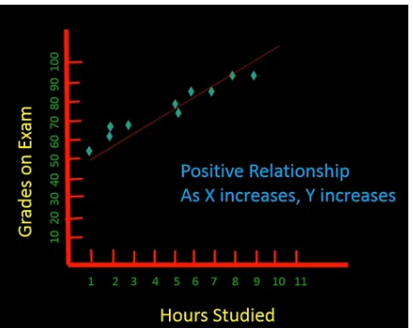
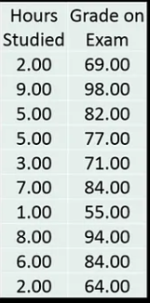
Example Simple Linear Regression

Slide 14
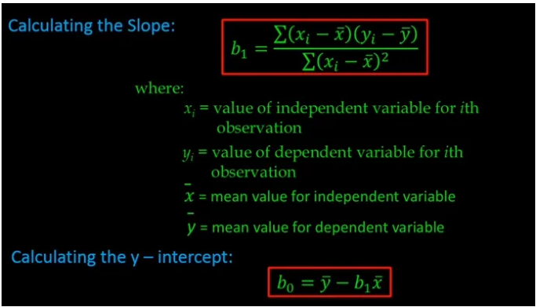
Example Simple Linear Regression

Slide 15
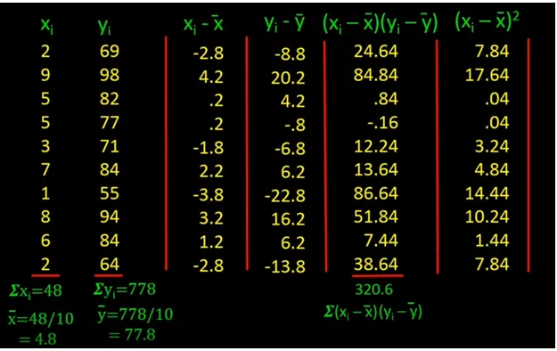

Slide 16
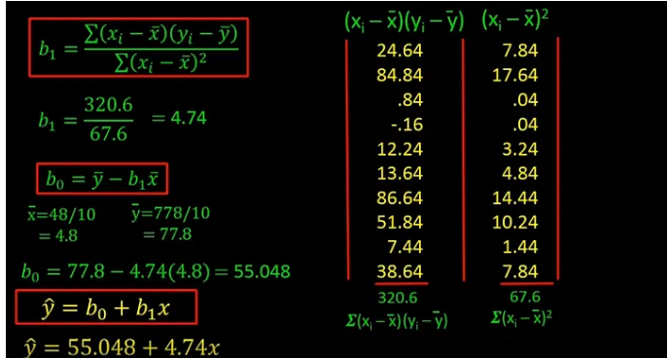
Example Simple Linear Regression

Slide 17
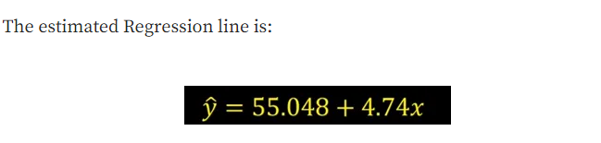
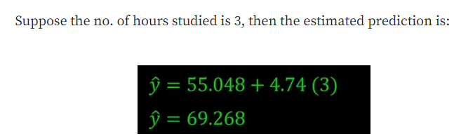
Example Simple Linear Regression

Slide 18

Multiple linear regression
Multiple linear regression is a method we can use to quantify the relationship between two or more predictor variables and a response variable.

Slide 19
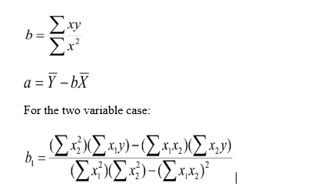
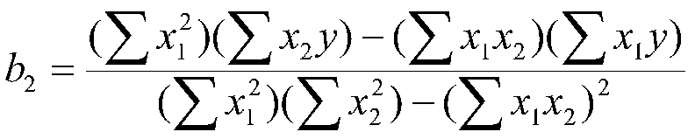
Multiple linear regression

Slide 20
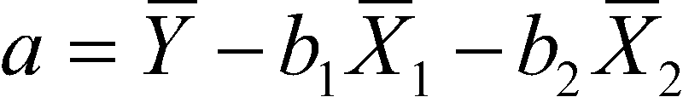
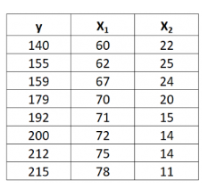
Multiple linear regression
The equation for a with two independent variables is:

Slide 21
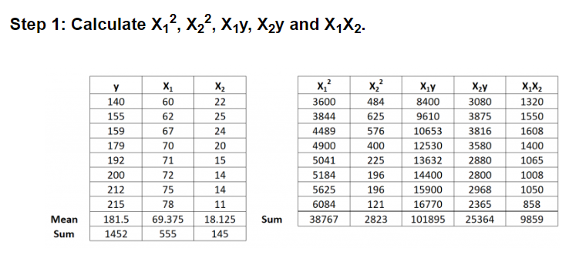
Multiple linear regression

Slide 22
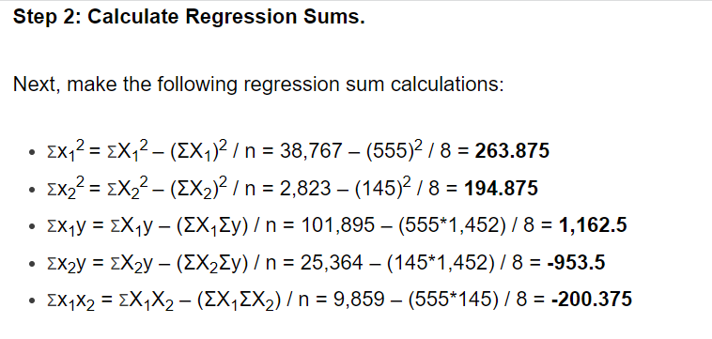
Multiple linear regression

Slide 23
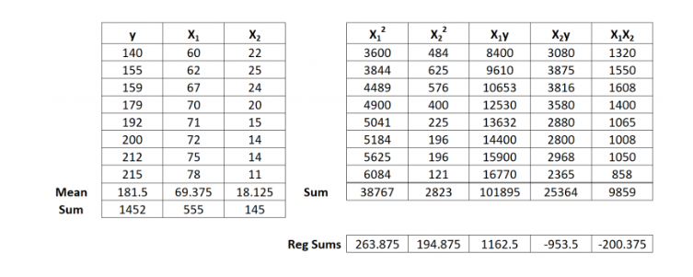
Multiple linear regression

Slide 24
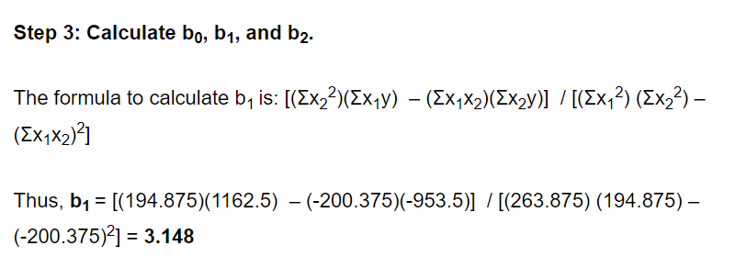
Multiple linear regression

Slide 25
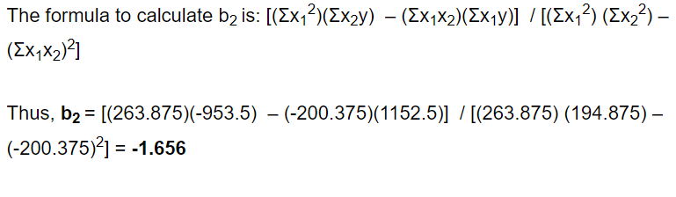
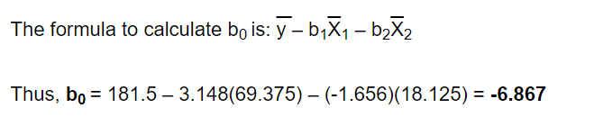
Multiple linear regression

Slide 26
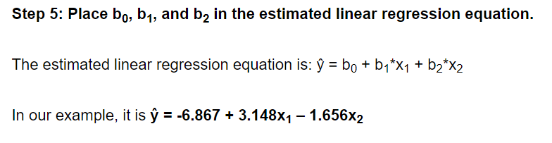
Multiple linear regression

Slide 27
Simple Linear Regression in Machine Learning
Here we are taking a dataset that has two variables: salary (dependent variable) and experience (Independent variable). The goals of this problem is:
We want to find out if there is any correlation between these two variables
We will find the best fit line for the dataset.
How the dependent variable is changing by changing the independent variable.

Slide 28
Step-1: Data Pre-processing
First, we will import the three important libraries, which will help us for loading the dataset, plotting the graphs, and creating the Simple Linear Regression model.
import numpy as nm
import matplotlib.pyplot as mtp
import pandas as pd
Next, we will load the dataset into our code:
data_set= pd.read_csv('Salary_Data.csv')

Slide 29
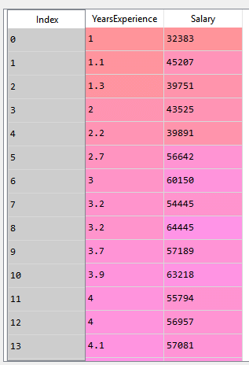
Step-1: Data Pre-processing

Slide 30
Step-1: Data Pre-processing
After that, we need to extract the dependent and independent variables from the given dataset.
The independent variable is years of experience, and the dependent variable is salary.
Below is code for it:
x= data_set.iloc[:, :-1].values
y= data_set.iloc[:, 1].values

Slide 31
Step-1: Data Pre-processing
Next, we will split both variables into the test set and training set.
We have 30 observations, so we will take 20 observations for the training set and 10 observations for the test set.
We are splitting our dataset so that we can train our model using a training dataset and then test the model using a test dataset. The code for this is given below:
# Splitting the dataset into training and test set.
from sklearn.model_selection import train_test_split
x_train, x_test, y_train, y_test= train_test_split(x, y, test_size= 1/3, random_state=0)

Slide 32
Step-2: Fitting the Simple Linear Regression to the Training Set:
Now the second step is to fit our model to the training dataset.
To do so, we will import the Linear Regression class of the linear_model library from the scikit learn.
After importing the class, we are going to create an object of the class named as a regressor. The code for this is given below:
#Fitting the Simple Linear Regression model to the training dataset
from sklearn.linear_model import LinearRegression
regressor= LinearRegression()
regressor.fit(x_train, y_train)

Slide 33
Step: 3. Prediction of test set result:
So, now, our model is ready to predict the output for the new observations.
In this step, we will provide the test dataset (new observations) to the model to check whether it can predict the correct output or not.
We will create a prediction vector y_pred, and x_pred, which will contain predictions of test dataset, and prediction of training set respectively.
#Prediction of Test and Training set result
y_pred= regressor.predict(x_test)
x_pred= regressor.predict(x_train)

Slide 34
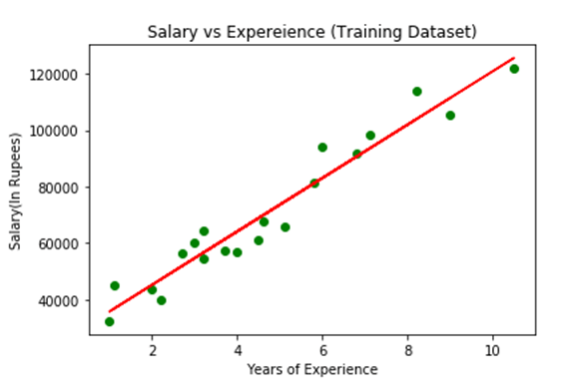
Step: 4. visualizing the Training set results:
mtp.scatter(x_train, y_train, color="green")
mtp.plot(x_train, x_pred, color="red")
mtp.title("Salary vs Experience (Training Dataset)")
mtp.xlabel("Years of Experience")
mtp.ylabel("Salary(In Rupees)")
mtp.show()

